Slide 1
C# Network Programming
The C# Language

Slide 2
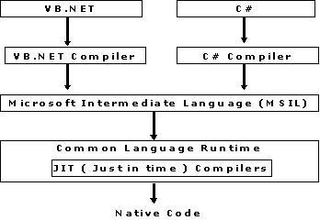
CLR

Slide 3
Encapsulation
using system;
public class Department {
private string departname;.......
// Accessor.
public string GetDepartname() {
return departname;
}
// Mutator.
public void SetDepartname(string a) {
departname = a;
}
}

Slide 4
Class Namespaces
System: Base .NET classes that define commonly used data types and data conversions
System.IO: Allows reading and writing on data streams and files
System.Net: Provides access to the Windows network functions
System.Net.Sockets: Provides access to the Windows sockets (Winsock) interface

Slide 5
String Methods
public static void Main ()
{
string test1 = "This is a test string";
string test2, test3;
test2 = test1.Insert(15, "application ");
test3 = test1.ToUpper();
Console.WriteLine("test1: '{0}'", test1);
Console.WriteLine("test2: '{0}'", test2);
Console.WriteLine("test3: '{0}'", test3);
if (test1 == test3)
Console.WriteLine("test1 is equal to test3");
else
Console.WriteLine("test1 is not equal to test3");
test2 = test1.Replace("test", "sample");
Console.WriteLine("the new test2: '{0}'", test2);
}
}

Slide 6
Exception Handling
try
{
// one or more lines of code
}
catch ()
{
// one or more lines of code to execute if an error
}
finally
{
// one or more lines of code to execute at all times
}

Slide 7
Checklist
All pillars
Ch # 1 all listings ( string method, exception handling)
Ch # 2: All listing (IP addresses, DNS, endpoints)
Project Idea
First client server connection

Slide 8
Chapter 2
: IP Programming Basics

Slide 9
IP protocol
The Internet Protocol (IP) is at the core of network programming. IP is the vehicle that transports data between systems, whether within a local area network (LAN) environment or a wide area network (WAN) environment.

Slide 10
Overview
The Internet Protocol (IP) is at the core of network programming. IP is the vehicle that transports data between systems, whether within a local area network (LAN) environment or a wide area network (WAN) environment.
IP provides the most robust technique for sending data between network devices

Slide 11
Overview
Programming using IP is often a complicated process.
There are many factors to consider concerning how data is sent on the network:
Number of client and server devices
Type of network
Network congestion
Error conditions on the network

Slide 12
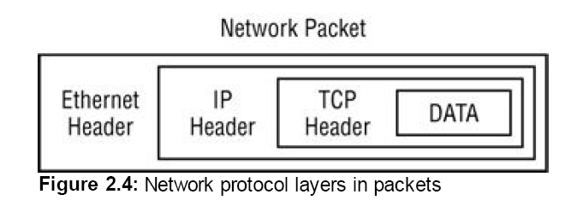
Network Packet

Slide 13
The Ethernet Layer
Each Ethernet packet conforms to a predetermined layout:
A 6-byte destination Ethernet (or MAC) address
A 6-byte source Ethernet (or MAC) address
A 2-byte next-layer protocol identifier
A data payload of 46 to 1500 bytes

Slide 14
The TCP Layer
Once the connection is established, data can be sent between the devices without the application having to check for lost or out-of-place data.
For a network programmer, it is a good idea to have a basic understanding of how TCP works, and especially how it moves data between devices on the network.

Slide 15
The TCP Layer
Each of the many fields in the TCP Header is associated with a particular function in the TCP session. The functions worth looking at are as follows:
The tracking of multiple connections between devices (source and destination ports)
The tracking of packet order and requests for retransmission of lost packets (sequence and acknowledgement numbers)
The opening and closing of connection streams between devices for data transmission (TCP flags)

Slide 16
TCP Application Ports
To communicate with an application on a remote device, you must know two pieces of information:
The remote device’s IP address
The TCP port assigned to the remote application

Slide 17
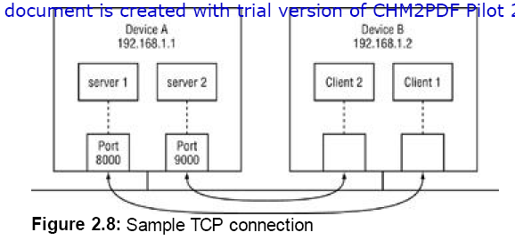
Sample TCP Connection
Notes:
In Figure 2.8, network device A is running two server applications, waiting for incoming packets from remote
devices. One application is assigned TCP port 8000 on the device, and the other is assigned port 9000. Networkdevice B is a client that wants to connect to the applications on the server. For a device to send a packet to a remote
device, it too must obtain a free TCP port from the operating system, which remains open for the duration of the
session. The client TCP port number is usually not important and can be assigned to any available port on the device.
The client forwards the packet from an available port on Device B to the application TCP ports on Device A.

Slide 18
IP Endpoint
The combination of an IP address and a port number defines an IP endpoint. A TCP session is defined as the combination of a local IP endpoint and a remote IP endpoint. Only one session can have both these properties the same. A single network application can use the same local IP endpoint, but each remote connection must have either a separate IP address or remote port number.

Slide 19
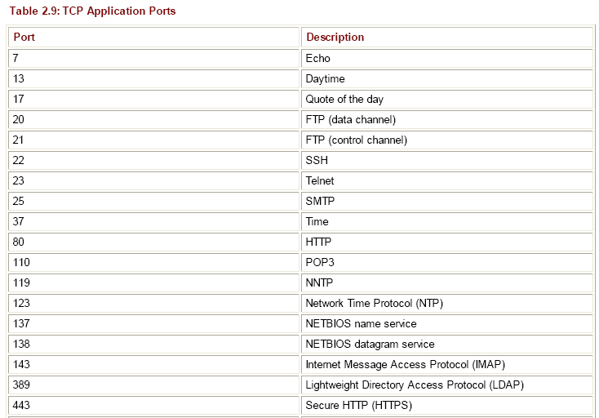
Well Know Port Numbers

Slide 20
Ensuring Packet Reliability
After the ports, the next fields in the TCP header are the sequence and acknowledgement numbers. These values allow TCP to track packets and ensure they are received in the proper order from the network. If any packets are missing, the TCP system can request a retransmission of the missing packets and reassemble the data stream before passing it off to the application.

Slide 21
Establishing a TCP Session
TCP uses connection states to determine the status of a connection between devices. A specific handshaking protocol is used to establish these connections and to monitor the status of the connection during the session. The TCP session has three phases:
Opening handshake
Session communication
Closing handshake

Slide 22
Establishing a TCP Session
Each phase requires the flag bits to be set in a certain order. The opening handshake is often called the three-way handshake and requires three steps to establish the connection:
1. The originating host sends a SYN flag to indicate the start of a session.
2. The receiving host sends a both a SYN flag and an ACK flag in the same packet to indicate it accepts the start of the session.
3. The originating host sends an ACK flag to indicate the session is open and ready for packets.

Slide 23
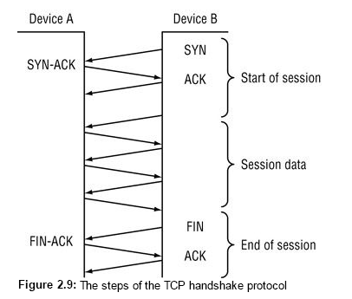
Example of TCP Session

Slide 24
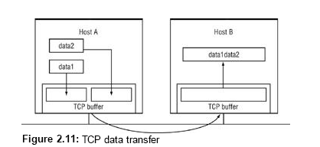
Programming with TCP and UDP
TCP Programming Features
Because of the separate TCP buffer, data moving between your program and the destination program on the remote host is handled somewhat differently than what you might expect.

Slide 25
Problem with TCP
Because TCP does not preserve data message boundaries, you must compensate for that in your network programs. There are two ways to handle this:
Create a protocol that requires a one-for-one response to each data message sent from the host
Design a data message marker system to distinguish data message boundaries within the data stream

Slide 26
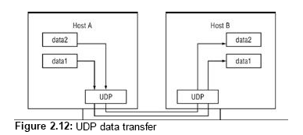
Programming with UDP

Slide 27
UDP Problem
You must ensure that your program can deal with missing data packets. This makes sending data via UDP a four-step process:
1. Send data to the remote device.
2. Start a timer, set for a predetermined period of time.
3. Wait for a response from the remote device. When it arrives, stop the timer and go on with your program.
4. If the timer expires before you receive a response, go back and repeat step 1. After you have repeated step 1 a set number of times (the retry count) without an answer, assume that you cannot communicate with the remote host.
Although sending data using UDP is somewhat easier as far as message boundaries go, it is a lot more complicated than TCP because you need to do your own checking for lost data packets.

Slide 28
Ip addresses
IPAddress test1 = IPAddress.Parse("192.168.1.104");
IPAddress test2 = IPAddress.Loopback;
IPAddress test3 = IPAddress.Broadcast;
IPAddress test4 = IPAddress.Any;
IPAddress test5 = IPAddress.None;
Console.WriteLine("Broadcast address: {0}",
test3.ToString());
Console.WriteLine("The ANY address is: {0}",
test4.ToString());
Console.WriteLine("The NONE address is: {0}",
test5.ToString());
Console.ReadLine();

